Slide 1
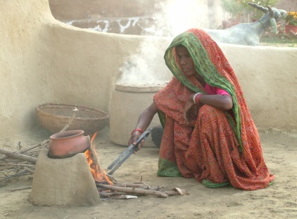
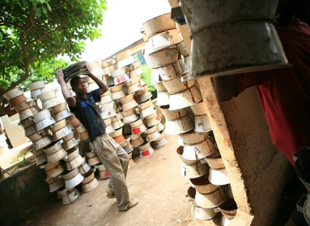
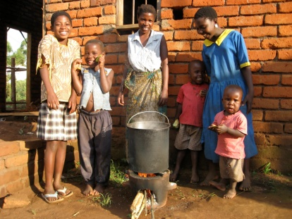
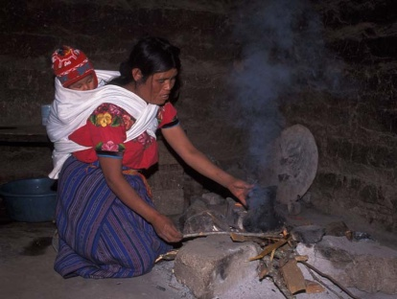
Global Alliance for Clean Cookstoves
A new public-private partnership led by the United Nations Foundation seeking to create a thriving global market for clean cookstoves in the developing world in order to:
Save lives by reducing exposure to cookstove smoke;
Empower women through productive enterprises associated with stove use, distribution, and production;
Improve livelihoods by reducing disease, freeing time and saving money (which can be used for the purchase of food, medicine, or school fees) and many other social benefits (e.g. clean kitchen, leisure time for women, pride in a modern product, etc);
Combat climate change by mitigating emissions of black carbon and greenhouse gases
Advance Millennium Development Goals related to poverty, health, gender equality, and the environment.
Photo Credit: Sunil Lal
Photo Credit: E+Co
Photo Credit: GTZ
Photo Credit: Nigel Bruce

Slide 2
Founding Partners
Deutsche Gesellschaft für Technische Zusammenarbeit (GTZ) GmbH
German Federal Ministry for Economic Cooperation and Development (BMZ)
Government of Norway
Government of Peru
Morgan Stanley /Morgan Stanley Foundation
Shell Corporation
Shell Foundation
SNV: Netherlands Development Organisation
UN-Energy
UN Environment Programme
UN Development Programme
UN Foundation
UN High Commissioner for Refugees
UN Industrial Development Organization
U.S. Agency for International Development
U.S. Department of Energy
U.S. Department of Health and Human Services (NIH and CDC)
U.S. Environmental Protection Agency
World Health Organization
World Food Programme
**In cooperation with other leading non-profit organizations, foundations, academic institutions, corporate leaders, governments, and UN agencies

Slide 3
What Does Success Look Like in 10 Years’ Time?
Adoption of 100 million clean and efficient cookstoves by 2020 (equal to roughly 20 percent of the globally affected population)
Investments to address the issue on par with funding for other public health and climate risks of a similar nature and severity
Development of a mature global cookstoves industry that can supply clean and efficient cooking solutions – stoves and/or fuels – to the developing world at scale and at low cost
Demonstration of the health, climate and economic benefits of clean and efficient cooking solutions through development of a robust research, monitoring and evaluation agenda

